Slide 1


Baseball III
Produced by Dr. Mario | UNC STOR 390

Slide 2

Linear Weights
S = Single
D = Double
T = Triple
HR = Home Run
BB = Walk
HBP = Hit-by-Pitch
SB = Stolen Base
CS = Caught
Stealing
Multiple Linear Regression
Baseball Application
$Y=Runs for the Season$
$\vec{X}={\left[BB+HBP,S,D,T,HR,SB,CS\right]}^{′}$
$Y={\vec{X}}^{′}\vec{β}+\vec{ε}$
$\hat{Y}=Predicted Runs$
$\hat{Y}={\vec{X}}^{′}\hat{\vec{β}}$
$$Y=β_{0}+β_{1}X_{1}+…+β_{k}X_{k}+ϵ$$
Linear Weights

Slide 3

Linear Weights
Crude Estimation of Linear Weight for Home Run
$\hat{β_{HR}}=E\left[\# of Runs\right|HR]=\frac{\# of Runs}{HR}$
Fact 1a: $\frac{4.8 Runs Per Game}{38 Batters Per Game}=0.126 Runs Per Batter$
Fact 2a: $\frac{4.8 Runs Per Game}{13 Batters Reach Base}=0.369 Runs Per Base Runner$
Suppose Batter Hits Home Run and Average of 1 Base Runner
Both Batter and Base Runner Score 100% of the Time
Fact 1b: $0.874 Runs Per Home Run Batter$
Fact 2b: $0.631 Runs Per Base Runner in a Home Run$
Therefore,
$$\frac{\# of Runs}{HR}=0.874+0.631=1.505 Runs$$

Slide 4

Linear Weights
Estimated Linear Weights Using Least Squares
Predictor | Estimate
Constant | -563.03
Single | 0.63
Double | 0.72
Triple | 1.24
HR | 1.5
BB+HBP | 0.35
SB | 0.06
CS | 0.02
$$n=210$$
$$R^{2}=0.91$$
$$Adj. R^{2}=0.91$$
Doesn’t Add Marginal Value

Slide 5
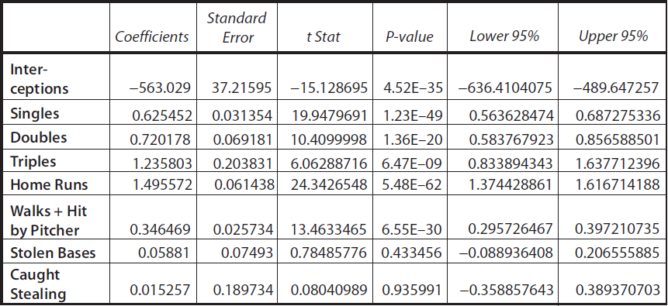
Linear Weights
Important Information From Linear Regression

Slide 6
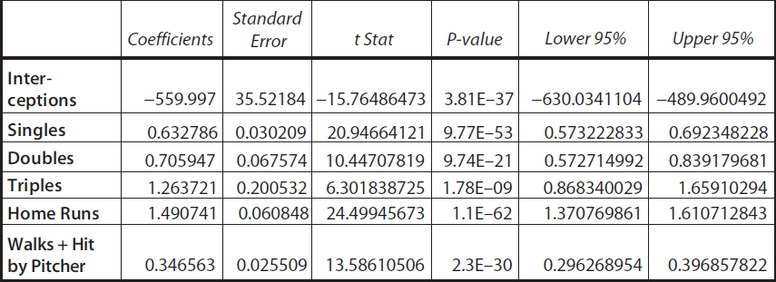

Linear Weights
Important Information From Linear Regression
Removal of Insignificant Variables
$RMSE=210$ and $MAD=210$ (Outperforms Previous)

Slide 7
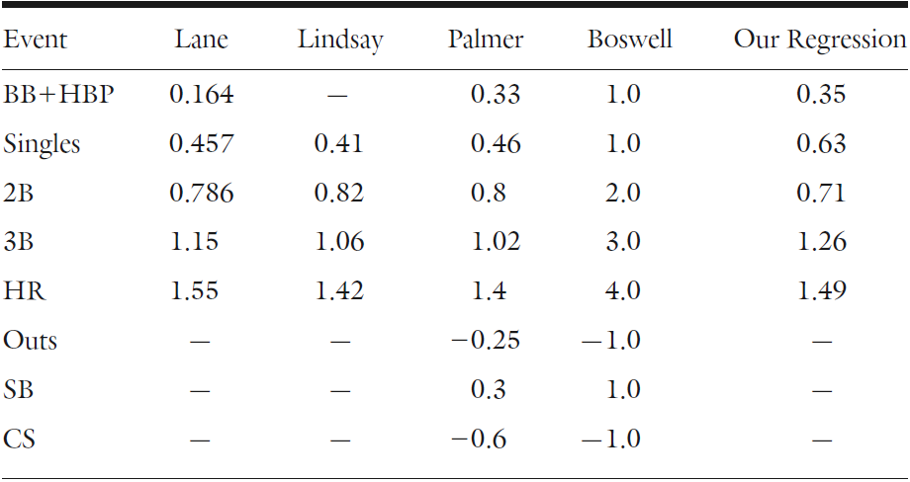
Linear Weights
Historical Progression
1916
1950-1960
1978
1989

Slide 8


Linear Weights
Evaluation of Hitters
Imagine if Team Had Only Barry Bonds (2004)
Approximately,
Bonds Hit 45 HR and Had 240.29 Outs
Therefore, Bonds Hit
Scaling Up, We Expect a Team of Bonds to Hit
Using Linear Weights, We Expect 3,259 Runs Per Season which Can Be Thought of 20.12 Runs Per Game
$$26.72×162=4329 Outs Per Season$$
$$\frac{45}{240.29} Home Runs Per Out$$
$$4329×\frac{45}{240.29}=811 Home Runs Per Season$$

Slide 9

Linear Weights
OBP, SLG, OPS, and Runs Created
Moneyball Highlights the Importance of OBP
From 2000-2006, Average OBP was 33%
Purpose of OPS = Value Power Hitters
Recall:
Which Covariate (OBP or SLG) is Better for Predicting Runs?
$$OPS=OBP+SLG$$
$=1×OBP+1×SLG$
Equal Weights

Slide 10
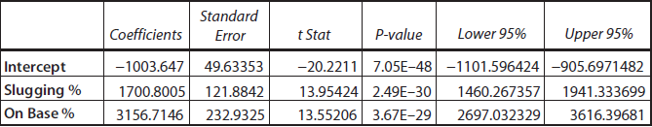

Linear Weights
OBP, SLG, OPS, and Runs Created
Multiple Regression
Summary: OBP Twice as Valuable as SLG
$$Runs=β_{0}+β_{1}(SLG)+β_{2}(OBP)+ϵ$$
$n=180$ & $R^{2}=0.91 \& Adj. R^{2}=0.91$

Slide 11
Linear Weights
Runs Created Above Average
How Many More Runs if Average Team Added a Player?
Average Team (2000-2006) Versus Ichiro (2004)
Hit Type | Average Team | Ichiro 2004
Single | 972.08 | 225
Double | 296 | 24
Triple | 30.82 | 5
HR | 177.48 | 8
BB+HBP | 599.88 | 60
Outs | 4329 | 451

Slide 12


Linear Weights
Runs Created Above Average
If Added, Rest of Players Will Cost an Approximate
For the Rest of The Team, This is Equivalent to
Singles With Ichiro Added to Roster
$$4329−451=3878 Outs$$
$$\frac{3878}{4329}=88\% of Total Outs$$
$Singles=0.88\left(Singles of Team\right)+(Singles of Ichiro$)

Slide 13
Linear Weights
Runs Created Above Average
Hit Type | Average Team | Ichiro | Ichiro+Team
Single | 972.08 | 225 | 1095.73
Double | 296 | 24 | 289.13
Triple | 30.82 | 5 | 32.60
HR | 177.48 | 8 | 166.98
BB+HBP | 599.88 | 60 | 597.33

Slide 14
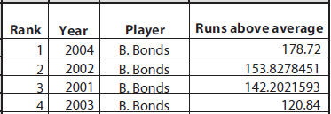
Linear Weights
Runs Created Above Average
Predicted Runs of Average Team = 780
Predicted Runs of Ichiro+Average Team = 839
Added Value of Ichiro = 839-780 = 59 Runs Above Average
Perspective:

Slide 15
Monte Carlo Simulation
Recall Evaluation of Hitter Effectiveness
Runs Created
Linear Weights
Both Based on Team Data
Scaled Player Information for Prediction
Problem: Player Hits HR 50% of Time = 54 RC/G
Definition of Monte Carlo Simulation
Developing a Computer Model to Repeatedly Play Out an Uncertain Situation
Used Across All Industries
Term Coined by Polish Physicist Stanislaw Ulam
Simple Simulation Shows Previously Discussed Player = 27 RC/G

Slide 16
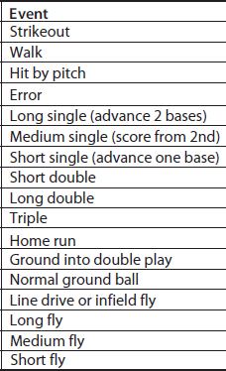
Monte Carlo Simulation
Simulating Runs from Team Full of Ichiros
Possible Plate Appearances Events
Long List of Assumptions
Errors Advance All Base Runners 1 Base
Long Single Advances Each Runner 2 Bases
Short Single Advances All Runners 1 Base
Short Double Advances Each Runner 2 Bases
Long Double Scores a Runner from First
Etc.
Assign Probabilities According to Relative Frequencies of Player
Program for Simulation

Slide 17
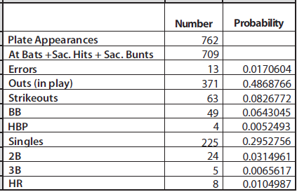
Monte Carlo Simulation
Simulating Runs from Team Full of Ichiros
Probabilities Based on Ichiro 2004 Statistics

Slide 18

Monte Carlo Simulation
Simulating Runs from Team Full of Ichiros
Probabilities of Special Cases
30% of Singles are Long Singles
50% of Singles are Medium Singles
20% of Singles are Short Singles
53.8% of Outs in Play are Ground Balls
15.3% of Outs in Play are Infield Flies
30.9% of Outs in Play are Fly Balls
Etc.
Result of Simulation = Within 1% of True Actual Runs Per Game
Specific to Ichiro
Random Number < 0.295 = Single
Random Number < 0.487 = Out
Goal of Simulation
Estimate # of Runs for Thousands of Innings
Average Across All Innings
Multiply by $\frac{26.72}{3}≈9$ to estimate RC/G

Slide 19
Monte Carlo Simulation
Results Under Simulation
Player | Year | RC/G
Ichiro | 2004 | 6.92
Nomar | 1997 | 5.91
Bonds | 0.72 | 21.02
Problem: Unusual # of Intentional Walks
Eliminating Intentional Walks: 15.98 RC/G

Slide 20
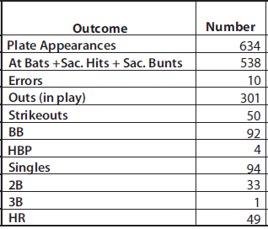
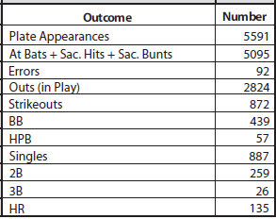
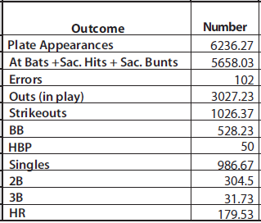
Monte Carlo Simulation
Added Value of Albert Pujols Measured by Runs
Team Without
Average
Team
Pujols Alone

Slide 21

America’s Greatest Pastime

Slide 22

Final Inspiration
If you don’t like sports,
you may like baseball.
- Mahatma Mario

